Slide 1
Praktikum Modellgetriebene Software-Entwicklung
Group: Schmitt, Steffen; Zhyla, Valerii; Klose, Frederik;

Slide 2
Overview
Meta Model
OCL
Xtext
QVTO (Palladio)
Xtend
Sirius

Slide 3


Workflow
Communication in Discord
Most of the time async
Because of the nature of the assignments
GitHub project
One branch per assignment for each dev
Todoist Board for planning

Slide 4
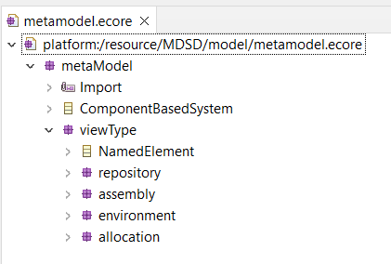
Metamodel
Main artifact
Iterative refinement
Small corrections
New ideas
Brainstorming

Slide 5
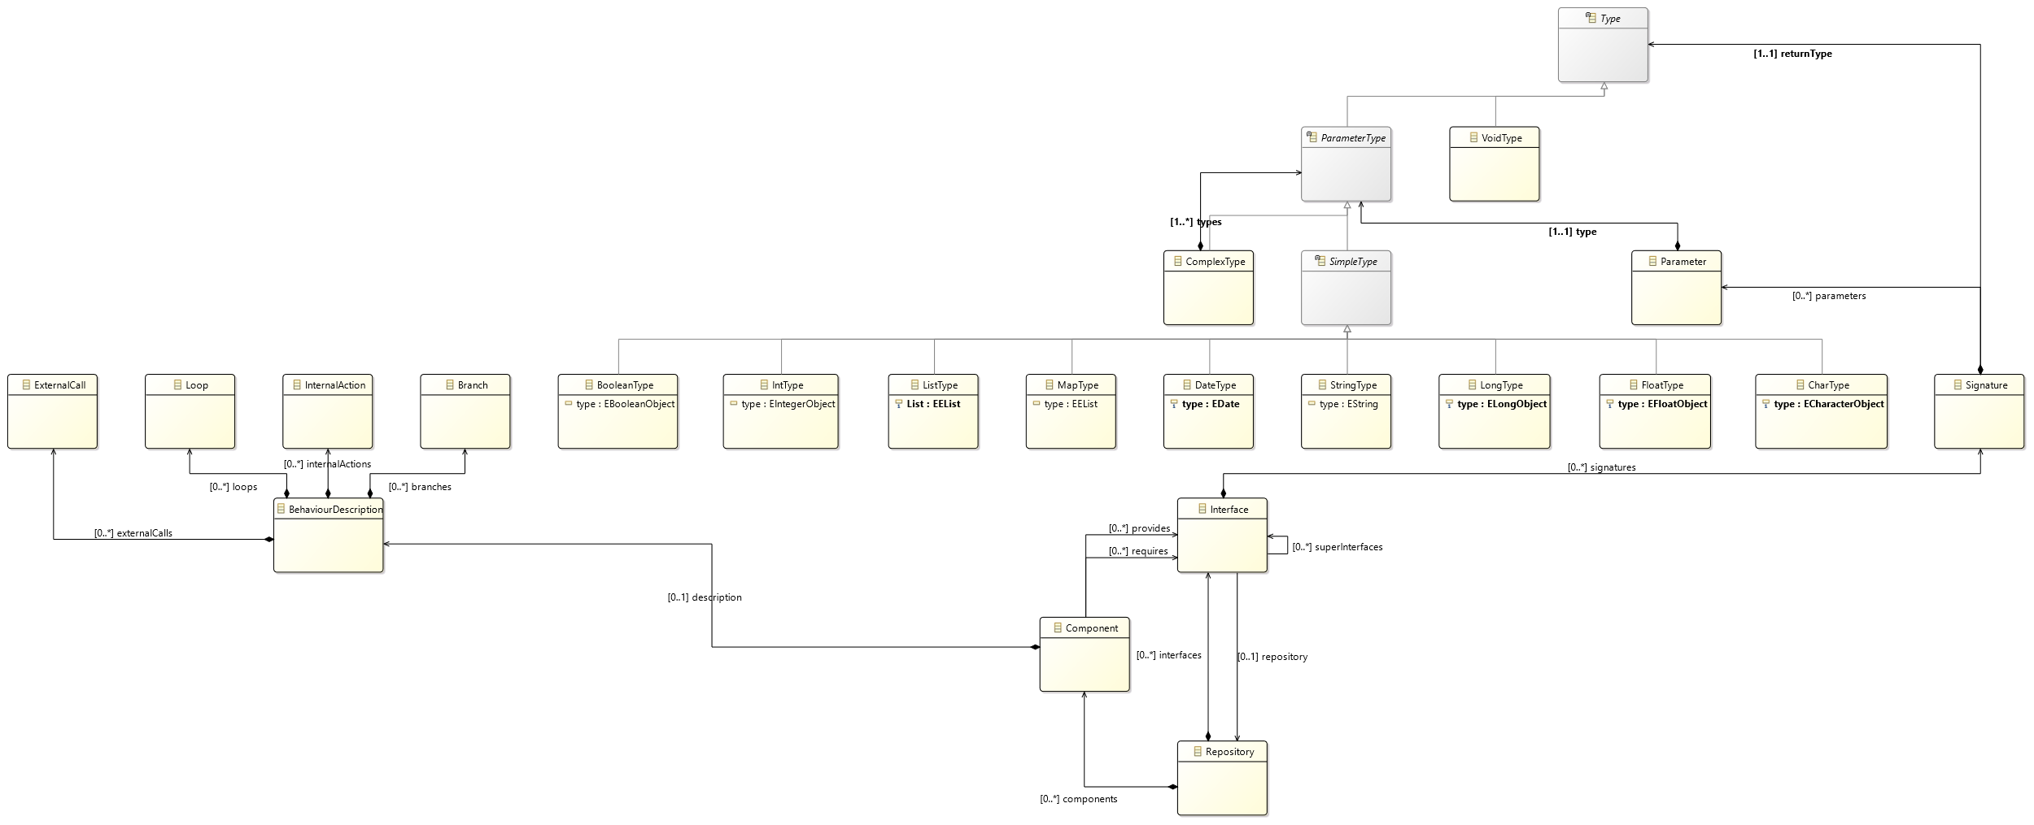
Metamodel

Slide 6
Metamodel
Constant confusion about the terms
Model?
Genmodel?
Metamodel?
Meta-metamodel?

Slide 7
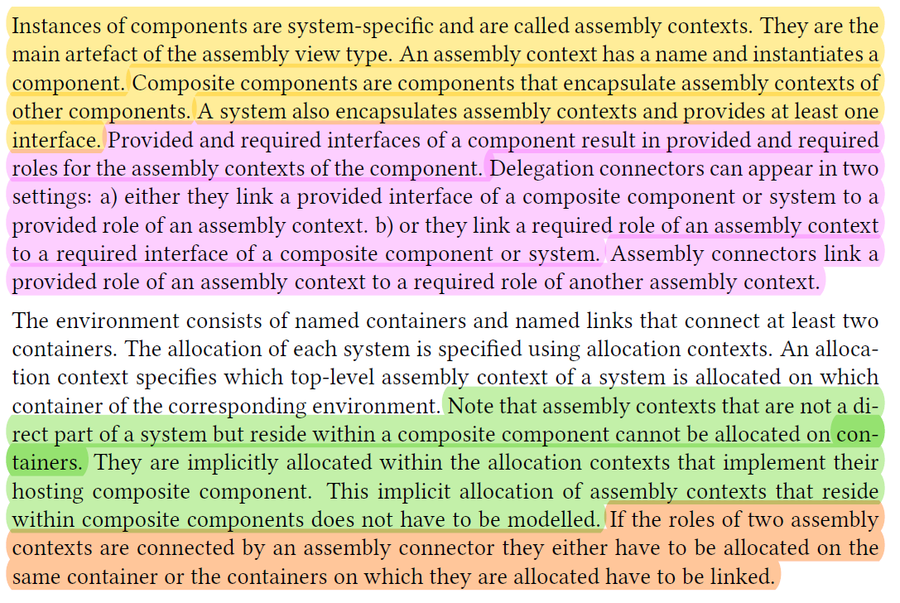
OCL - Workflow

Slide 8

OCL
One line to rule them all

Slide 9

OCL
2 hours for a single constraint? Why not?

Slide 10
Xtext
Installing Xtext: 10 hours
Create Domain Language:

Slide 11
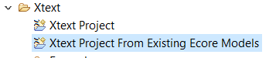
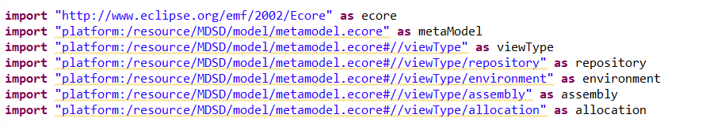

Xtext

Slide 12
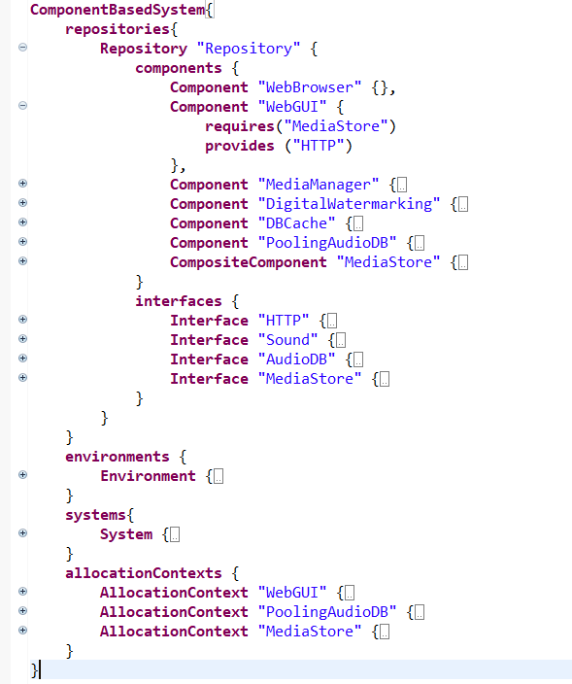
Xtext

Slide 13
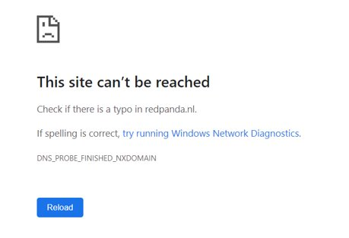

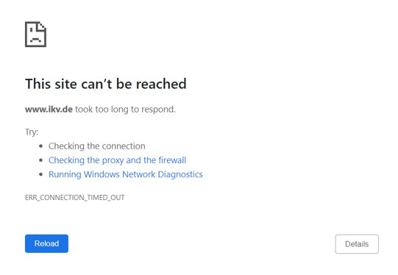
QVTO
Uncontested champion in the category:
"number of dead links in documentation"

Slide 14

QVTO

Slide 15
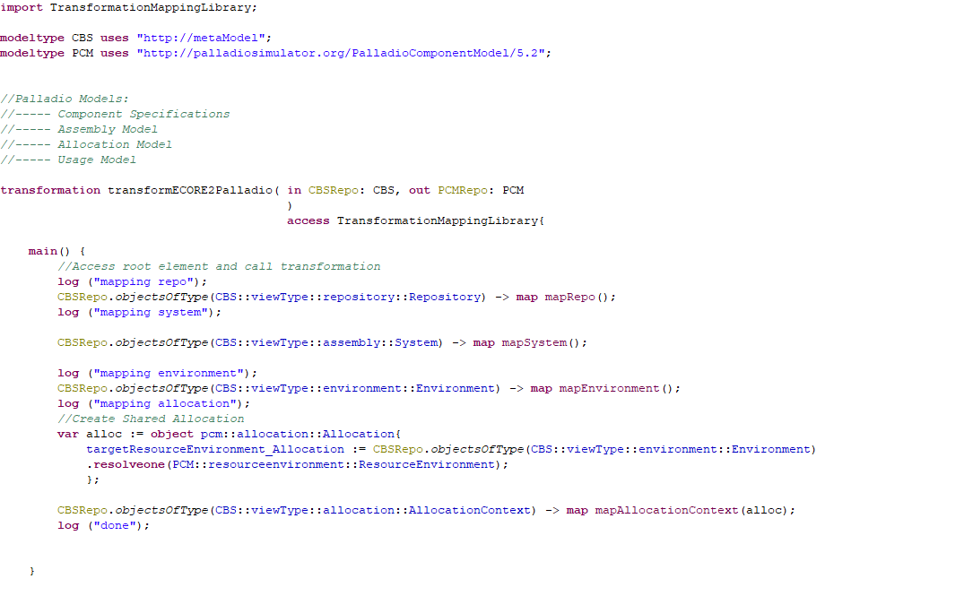
QVTO

Slide 16
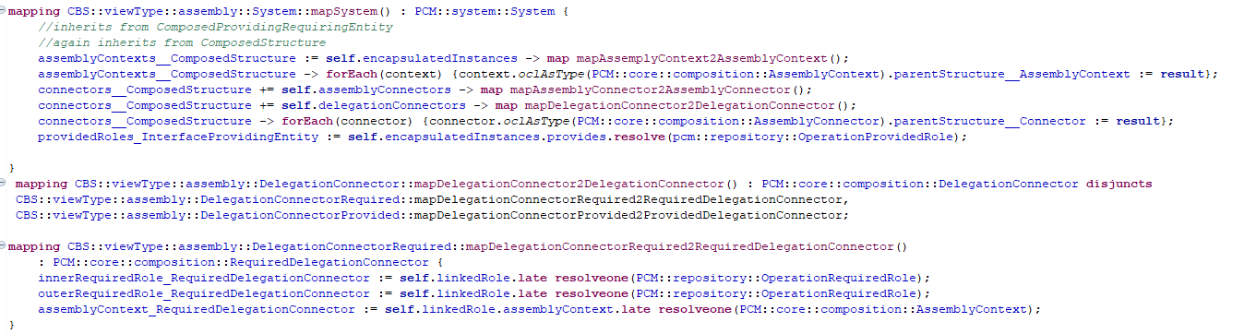
QVTO

Slide 17

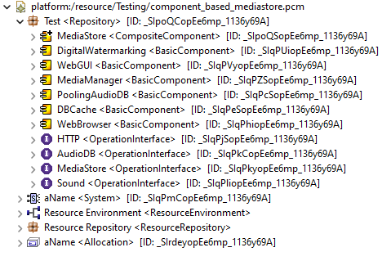
M2M Transformations

Slide 18
Palladio Problems
The PCM was actually well thought out
SEFFs
Last minute fix
Delegation Connectors
Incompatible with our meta model
Hard-code

Slide 19
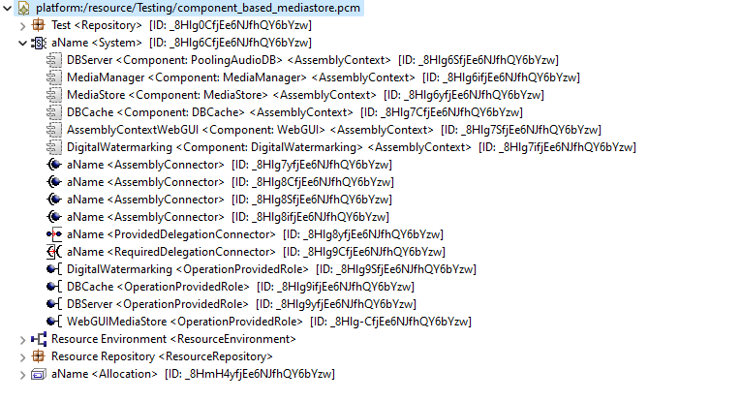
Palladio

Slide 20
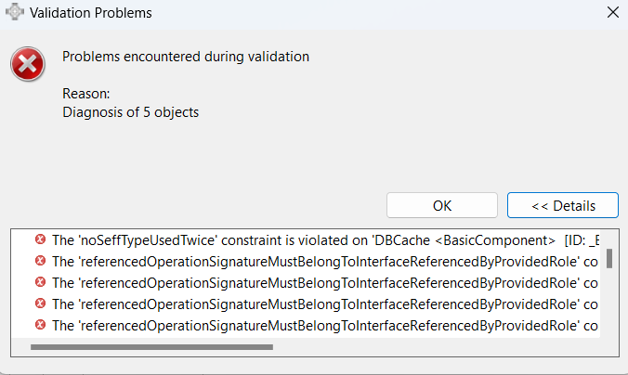
Palladio
Hours upon hours of trying to get our model transformed
But we (almost) got there in the end

Slide 21
Xtend
2 versions of getPackage
Static like the structure in example
Dynamic with package segment for each model element
Problems:
Tabulator in generated code vs in DslGenerator.xtend
Each Type is Element in Metamodel
No inherent mapping from type Element to the java data type
Mapping in Generator needed

Slide 22
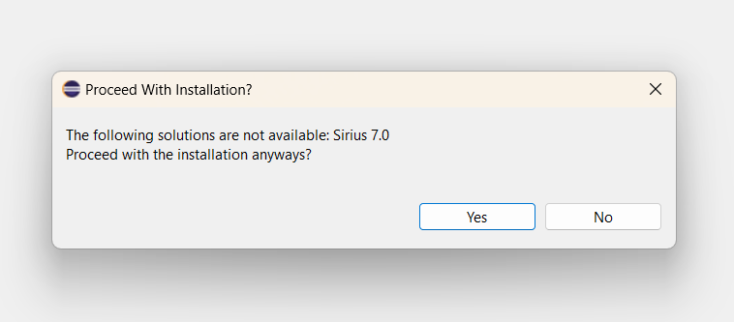
Sirius

Slide 23
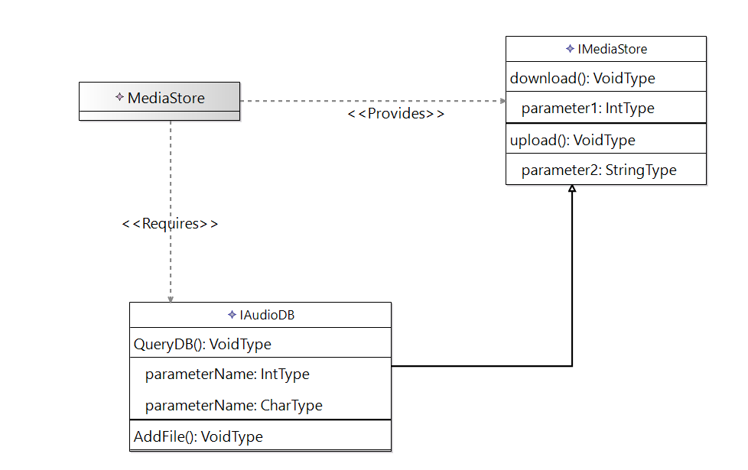
Sirius
Interesting concept
But very hard to make it work
Why doesn't it work?!
No feedback
No logs
No meaningful errors
No debugging

Slide 24
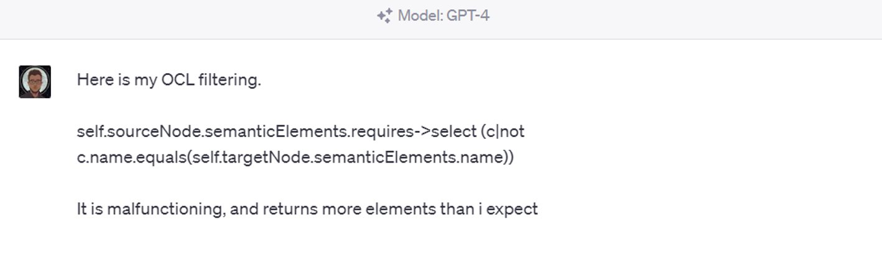
Sirius

Slide 25
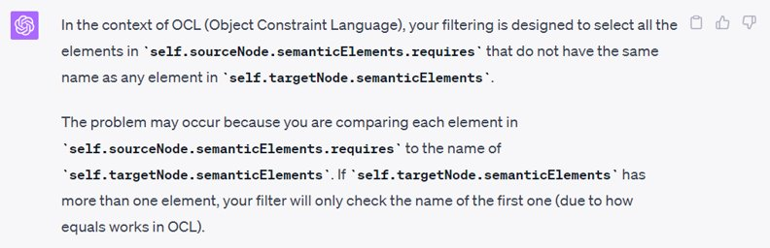
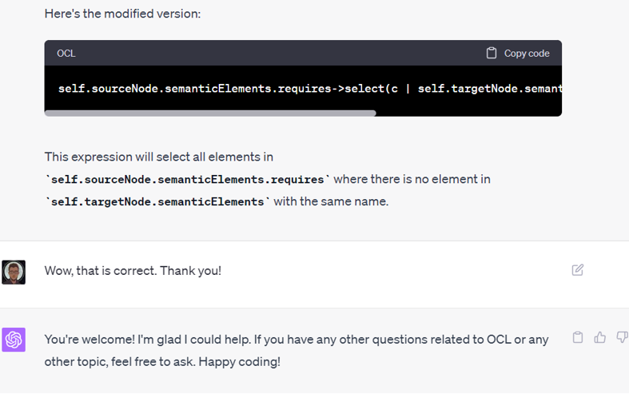
Sirius

Slide 26


Conclusion
We got a broad look of modelling technologies
Some of them were pretty good
And some were pretty dead
Finding new ways in which tools can be incompatible
Resilience to Eclipse debugging
Resilience to suppressed Exceptions
Stoicism
Great team work

Slide 27
References
https://github.com/steffenschmitt1/MDSD

